Slide 1
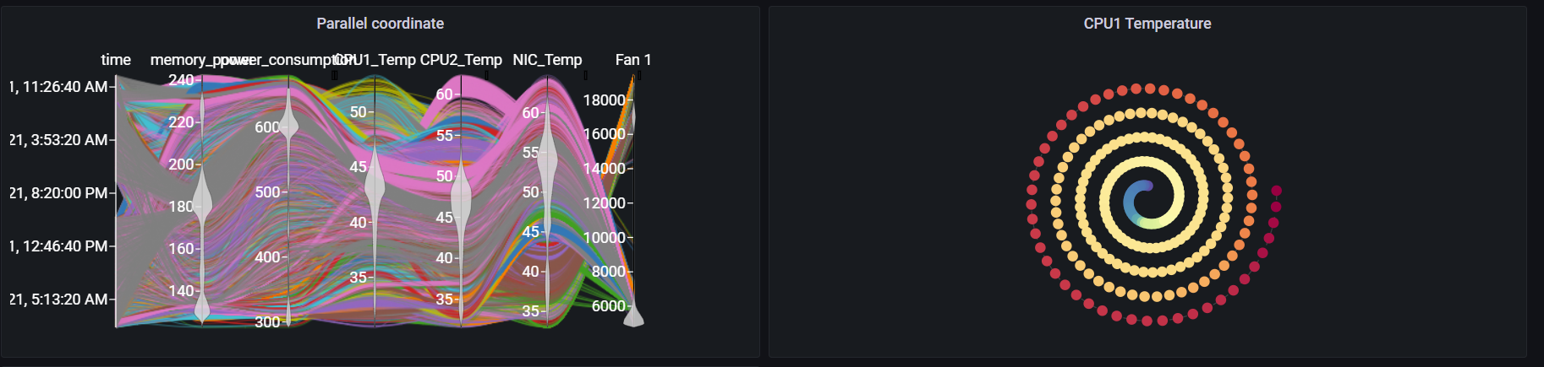
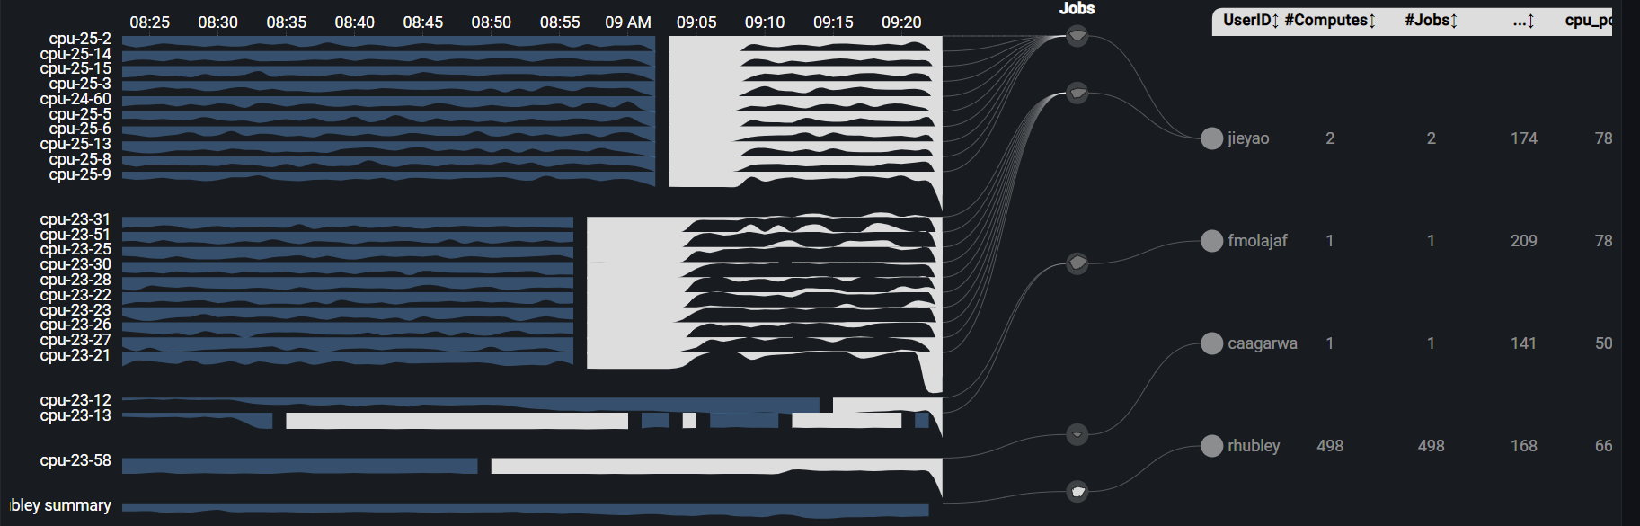
Grafana Plugin
Weekly report

Slide 2
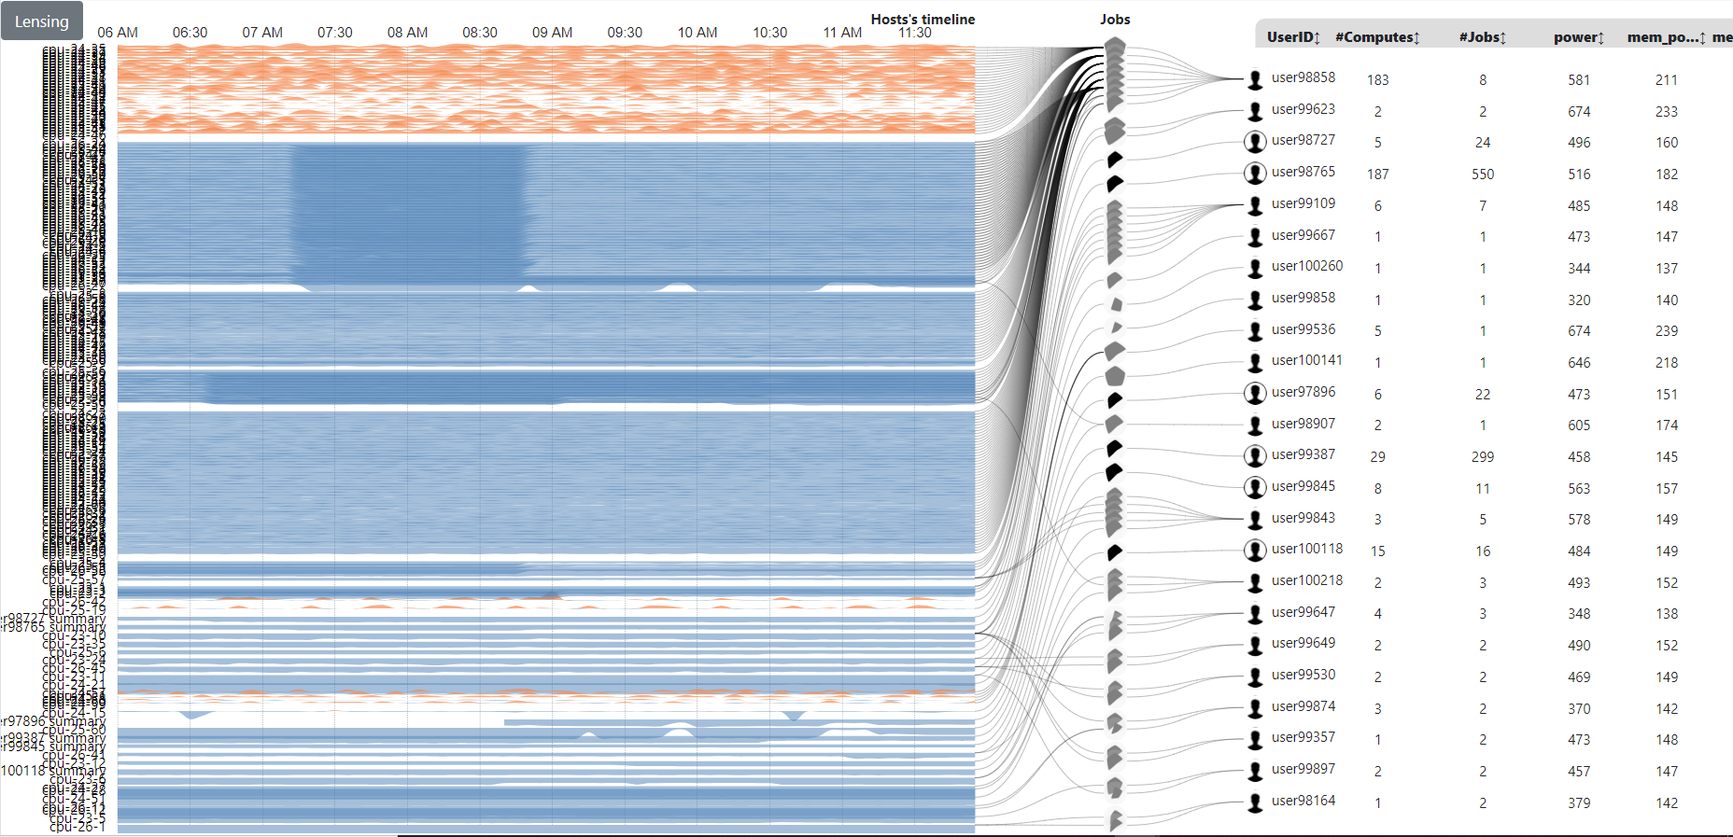
Original visualization
https://idatavisualizationlab.github.io/HPCC/PowerMap/

Slide 3
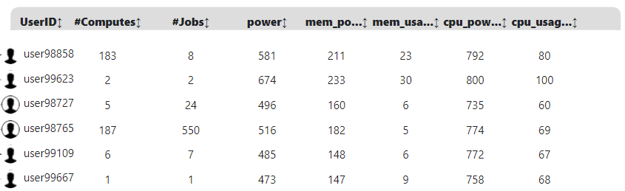


Power Map
https://idatavisualizationlab.github.io/HPCC/PowerMap/index.html
Users
Jobs
Computes
PowerMap auto collapse user with more than 10 jobs
Collapsed user : all jobs will display as 1 summary job only
Normal user: all jobs display

Slide 4
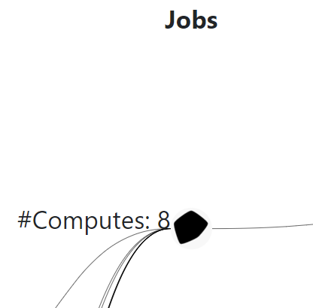

Power Map
https://idatavisualizationlab.github.io/HPCC/PowerMap/index.html
power
Users
Jobs
cpu_usage
mem_power
Computes
cpu_power
mem_usage
jobs: include multi job ids (job array/ summary job)
Single job

Slide 5
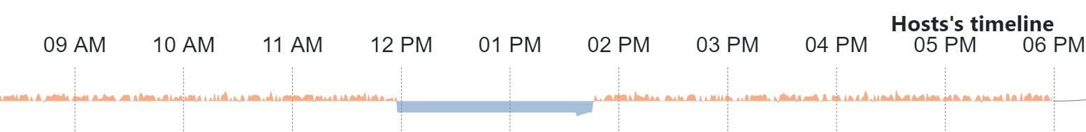
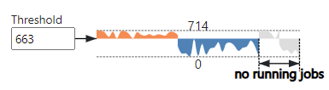
Power Map
https://idatavisualizationlab.github.io/HPCC/PowerMap/index.html
Users
Jobs
Computes
Orange: above Threshold
Blue: below Threshold

Slide 6
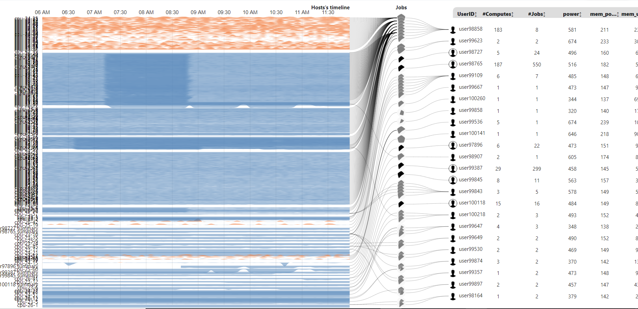
Power Map
Threshold: 675 watt
Power

Slide 7
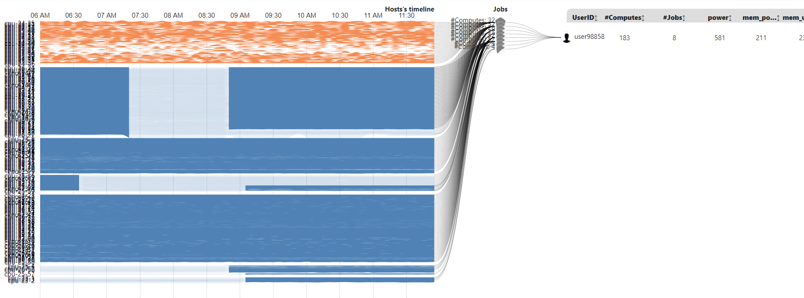
Power Map
Mouseover User/Job | Highlight running duration on compute
Jieyao
2 jobs sequence on same set of computes

Slide 8
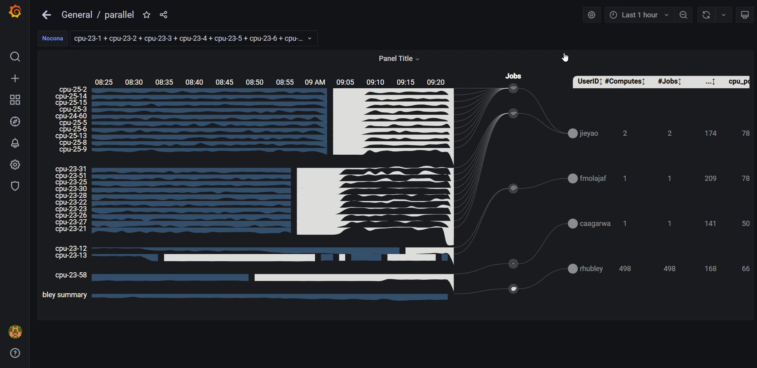
Current result
Primary app: https://idatavisualizationlab.github.io/HPCC/ParallelCoordinates/index.html

Slide 9
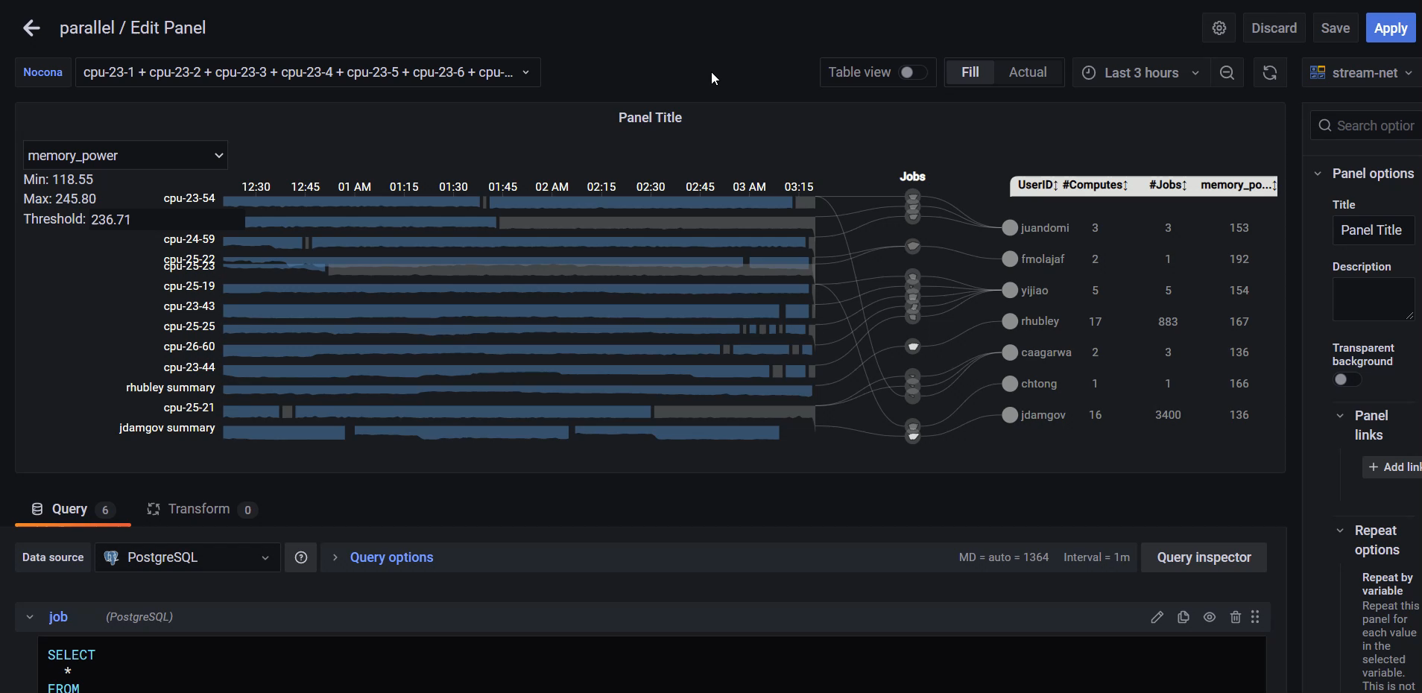
Current result
Primary app: https://idatavisualizationlab.github.io/HPCC/ParallelCoordinates/index.html

Slide 10
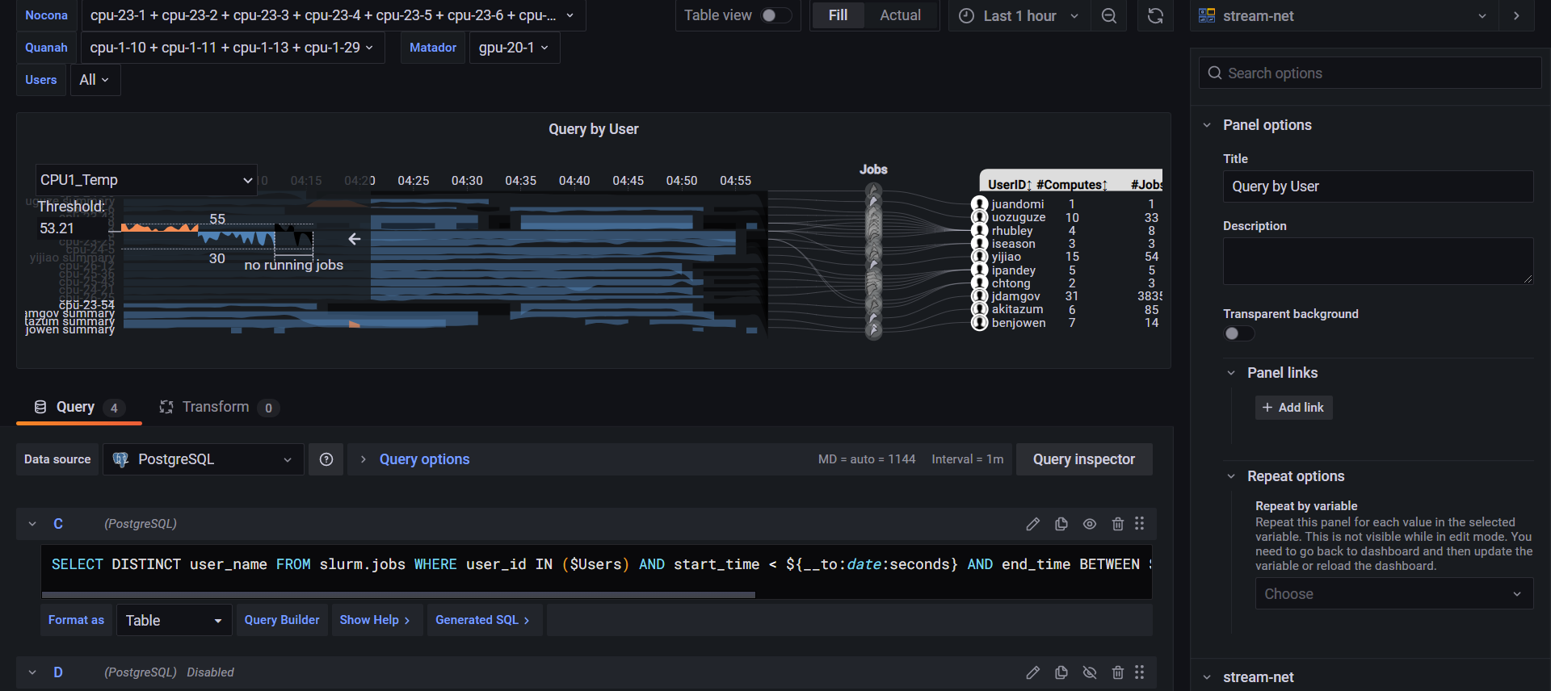
Current result
Primary app: https://idatavisualizationlab.github.io/HPCC/ParallelCoordinates/index.html

Slide 11
Current features
Power streamDisplay user/job/compute
Control stream threshold
Legend

Slide 12
Future features
Lensing
Filter function

Slide 13
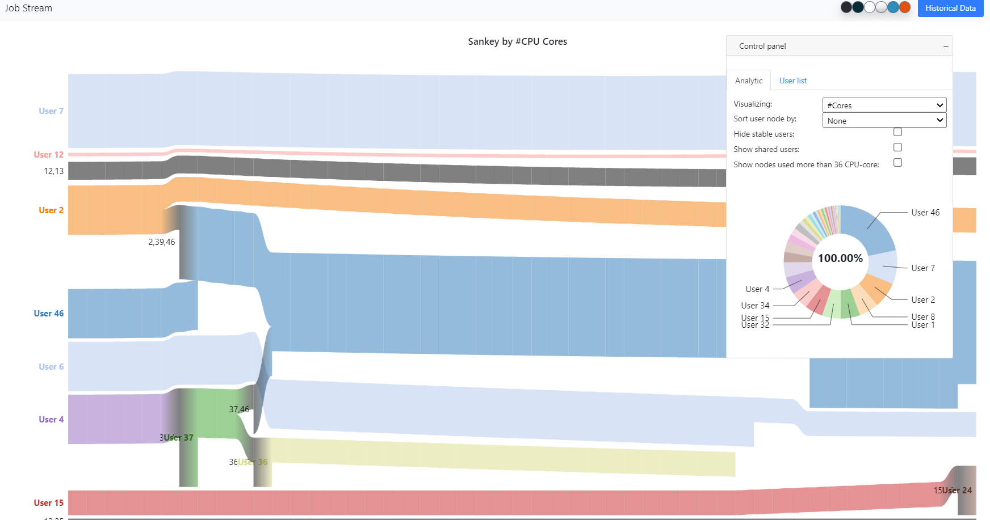
Working on
Sankey

